Slide 1
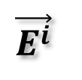

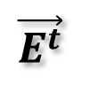
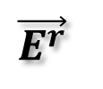
z
Z_{L}
$$\vec{E^{t}}$$
y
Z_{L}
$$τ$$
Freq.
$$\vec{E^{i}}$$
x
Γ
D_{Z}
l
$$\vec{E^{r}}$$
Freq.
D_{X}

Slide 2

x
x+d
x+2d
x+3d
x+4d
…
y
$$E_{z}^{inc}$$
Width (w)
x
Period (d)

Slide 3
Ak
d = 0.5λ₀
d = 0.5359λ₀
y
y
m = 0
E^{inc}
m = 0
E^{inc}
m = -1
x
x
m = -1
m = 0
m = 0
d = 1.0λ₀
d = 2.0λ₀
m = -2
y
y
m = -1
m = -1
m = -3
m = 0
E^{inc}
E^{inc}
m = 0
x
x
m = 0
m = 0
m = -1
m = -1
m = -3
m = -2

Slide 4








$$k_{z}^{inc}$$
$$k_{1}^{}$$
Incident Plane Wave
$$ε_{1,}μ_{1}$$
$$k_{x}^{inc}$$
$$Γ_{1}$$
Region 1
x₁
Unit Cell
Region 2
$$ε_{2,}μ_{2}$$
$$Γ_{2}$$
x₂
Region 3
x₃
x₃
$$ε_{1,}μ_{1}$$
D_{Z}
x₃→∞
x₃→∞

Slide 5
E^{inc}

Slide 6
z
Incident Plane Wave
θ
y
-Φ
Unit Cell
x
D_{y}
D_{x}

Slide 7
Low Pass
High Pass
Band Pass
Band Stop
f_{in}
f_{out}
f_{out}
f_{in}
f_{out}
f_{in}
f_{out}
f_{in}
f_{out}
f_{out}
Attenuation(dB)
Attenuation(dB)
Attenuation(dB)
Attenuation(dB)
Frequency(GHz)
Frequency(GHz)
Frequency(GHz)
Frequency(GHz)

Slide 8
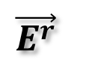
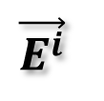
Strong Reflection
$$\vec{E^{i}}$$
Out of Band
Weak Return
In Band
Rader
Fuselage
Back scattering
$$\vec{E^{r}}$$
Band-Pass Hybrid Radome
(Ideally low RCS in Band)

Slide 9
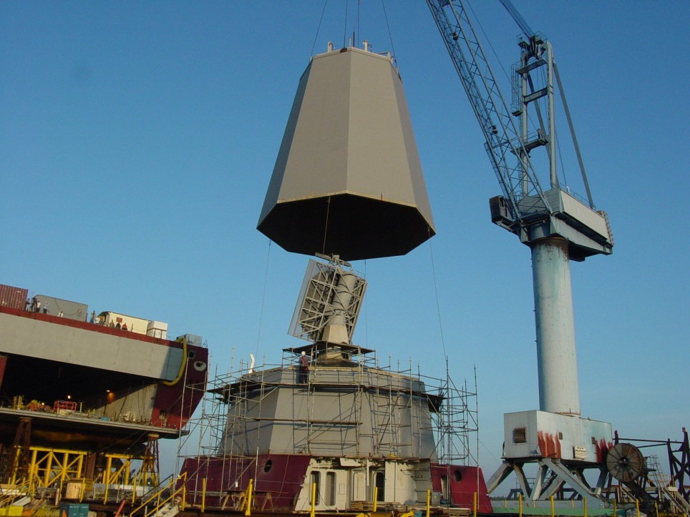
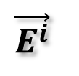
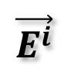
$$\vec{E^{i}}$$
Out of Band
Antenna 1
In Band
$$\vec{E^{i}}$$
Antenna 2
Ship Hull
Advanced Enclosed Mast with FSS
(Band Stop operation)

Slide 10
f₁
Antenna 1
f₂
Antenna 2
Dichoroic
Sub-refelctor
Antenna 1
Antenna 2
Cassegrain System
Offset Cassegrain System

Slide 11
Dipole Array
for X-band
Dielectric
Dichoroic
Surface
Q-band
Input
Q-band
X-band
X-band
Input
λ/2 at X=Band
Polarizer

Slide 12





Meander-line Polarizers
$$\vec{E^{v}}$$
$$\vec{E^{i}}$$
45º
$$\vec{E^{h}}$$
E^{v} ∠ +45º
CP
αE^{v} ∠ +45º
E^{h} ∠ -45º
$$\vec{E^{v}}$$
αE^{h} ∠ -45º
$$\vec{E^{h}}$$

Slide 13
Ground
②
①
③
y_{g}
y_{a} + y_{g}
y_{a}
Equivalent Circuit
d
d
Circuit Analog Sheet

Slide 14


②
①
③
y_{g}
y_{a} + y_{g}
y_{a}
Equivalent Circuit
Ground
d
f_{H}
①
f_{L}
$$ε_{2,}μ_{2}$$
$$ε_{1,}μ_{1}$$
y_{g}
y_{a} + y_{g}
f_{L}
f₀
f₀
∞
f_{H}
③
y_{a}
②
f_{L}
f_{H}
①
③
②
Frequency Response of Absorber
Side View of Absorber

Slide 15
Metal Boundary
Wireless Local Area Network
[Unwanted Signal]
Radio, TV Broadcasting and Cell Phone
[Wanted Signal]
Common Building
Base Station
Physical Shielded Building

Slide 16
FSS Shielded
Blocks External
Interference
Allows radio, TV and cell phone transmission
OFFICE 1
Eavesdropping
Base Station
Interference
OFFICE 2
OFFICE 3

Slide 17
λ_{r} / 2
λ_{r} /2
λ_{r} / 2

Slide 18
λ_{r} / 2
λ_{r} / 3
λ_{r} /2
λ_{r} / 2

Slide 20
Z₀
Z₀
Low
C
Increasing R
L
Attenuation
R
High
Freq.
Z₀
Z₀
High
Increasing R
L
C
Transmission
Increasing R
R
Low
Freq.

Slide 21
1.0
Γ or τ
Frequency

